Slide 1
Modelos IVR
Rio de Janeiro, Novembro 2022
Raul Ribeiro

Slide 2
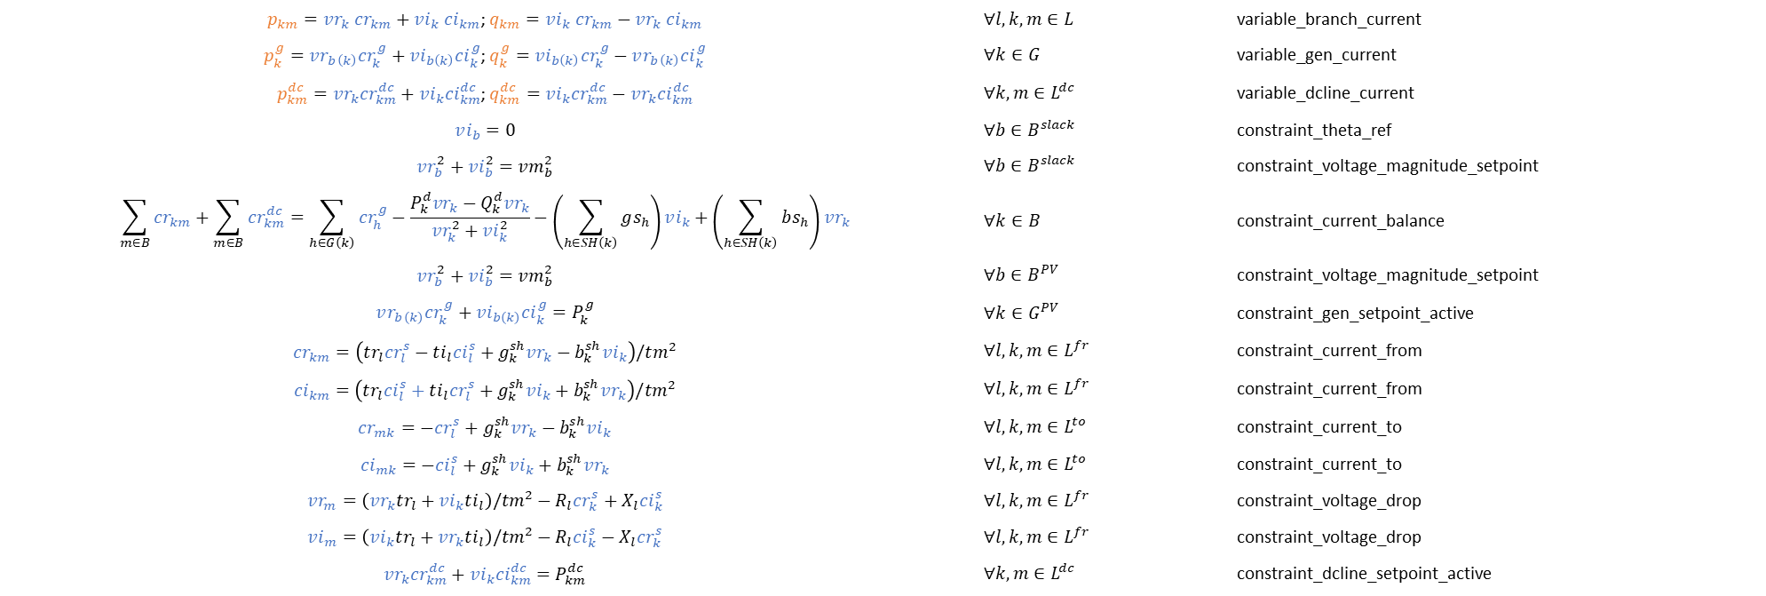
IVR - PowerModels
$p_{km}=vr_{k} cr_{km}+vi_{k} ci_{km}$; $q_{km}=vi_{k} cr_{km}−vr_{k} ci_{km}$ | $$∀l,k,m∈L$$ | variable_branch_current
$p_{k}^{g}=vr_{b\left(k\right)}cr_{k}^{g}+vi_{b\left(k\right)}ci_{k}^{g}$; $q_{k}^{g}=vi_{b\left(k\right)}cr_{k}^{g}−vr_{b\left(k\right)}ci_{k}^{g}$ | $$∀k∈G$$ | variable_gen_current
$p_{km}^{dc}=vr_{k}{cr}_{km}^{dc}+vi_{k}{ci}_{km}^{dc}$; $q_{km}^{dc}=vi_{k}{cr}_{km}^{dc}−vr_{k}{ci}_{km}^{dc}$ | $$∀k,m∈L^{dc}$$ | variable_dcline_current
$$vi_{b}=0$$ | $$∀b∈B^{slack}$$ | constraint_theta_ref
$$vr_{b}^{2}+vi_{b}^{2}=vm_{b}^{2}$$ | $$∀b∈B^{slack}$$ | constraint_voltage_magnitude_setpoint
$$\sum_{m∈B}{cr_{km}}+\sum_{m∈B}{cr_{km}^{dc}}=\sum_{h∈G\left(k\right)}{cr_{h}^{g}}−\frac{P_{k}^{d}vr_{k}−Q_{k}^{d}vr_{k}}{vr_{k}^{2}+vi_{k}^{2}}−\left(\sum_{h∈SH\left(k\right)}{gs_{h}}\right)vi_{k}+\left(\sum_{h∈SH\left(k\right)}{bs_{h}}\right)vr_{k}$$ | $$∀k∈B$$ | constraint_current_balance
$$vr_{b}^{2}+vi_{b}^{2}=vm_{b}^{2}$$ | $$∀b∈B^{PV}$$ | constraint_voltage_magnitude_setpoint
$$vr_{b\left(k\right)}cr_{k}^{g}+vi_{b\left(k\right)}ci_{k}^{g}=P_{k}^{g}$$ | $$∀k∈G^{PV}$$ | constraint_gen_setpoint_active
$$cr_{km}=\left(tr_{l}cr_{l}^{s}−ti_{l}ci_{l}^{s}+g_{k}^{sh}vr_{k}−b_{k}^{sh}vi_{k}\right)/tm^{2}$$ | $$∀l,k,m∈L^{fr}$$ | constraint_current_from
$$ci_{km}=\left(tr_{l}ci_{l}^{s}+ti_{l}cr_{l}^{s}+g_{k}^{sh}vi_{k}+b_{k}^{sh}vr_{k}\right)/tm^{2}$$ | $$∀l,k,m∈L^{fr}$$ | constraint_current_from
$$cr_{mk}=−cr_{l}^{s}+g_{k}^{sh}vr_{k}−b_{k}^{sh}vi_{k}$$ | $$∀l,k,m∈L^{to}$$ | constraint_current_to
$$ci_{mk}=−ci_{l}^{s}+g_{k}^{sh}vi_{k}+b_{k}^{sh}vr_{k}$$ | $$∀l,k,m∈L^{to}$$ | constraint_current_to
$$vr_{m}=\left(vr_{k}tr_{l}+vi_{k}ti_{l}\right)/tm^{2}−R_{l}cr_{k}^{s}+X_{l}ci_{k}^{s}$$ | $$∀l,k,m∈L^{fr}$$ | constraint_voltage_drop
$$vi_{m}=\left(vi_{k}tr_{l}+vr_{k}ti_{l}\right)/tm^{2}−R_{l}ci_{k}^{s}−X_{l}cr_{k}^{s}$$ | $$∀l,k,m∈L^{fr}$$ | constraint_voltage_drop
$$vr_{k}{cr}_{km}^{dc}+vi_{k}{ci}_{km}^{dc}=P_{km}^{dc}$$ | $$∀k,m∈L^{dc}$$ | constraint_dcline_setpoint_active
Variáveis: | $$v_{b}^{r},v_{b}^{i},c_{km}^{r},c_{km}^{i},{cs}_{l}^{r},{cs}_{l}^{i},cg_{k }^{r},cg_{k }^{i}$$

Slide 3
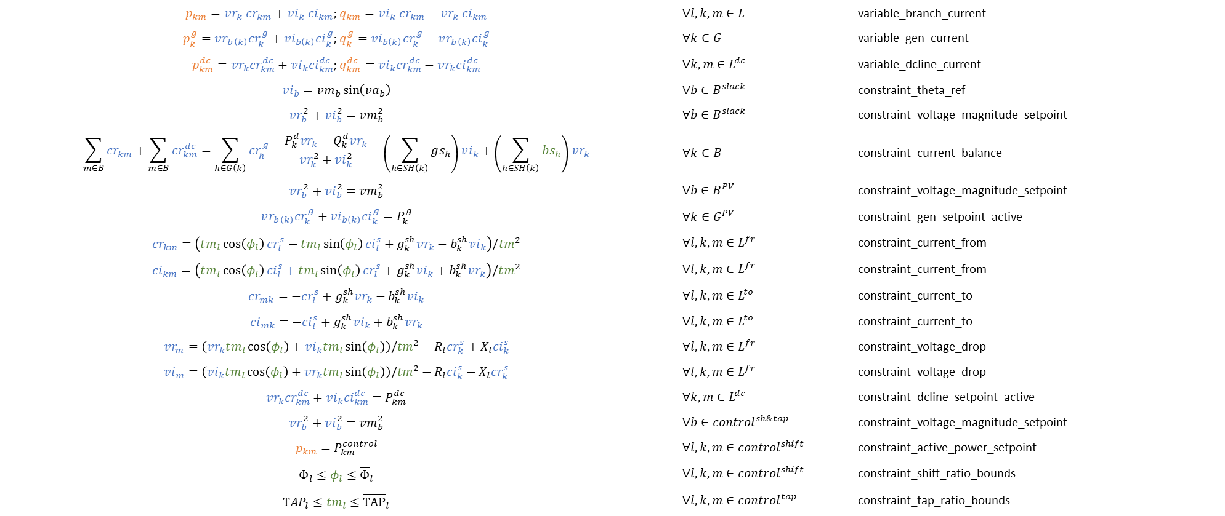
IVR com controle – ControlPowerFlow (Iago)
$p_{km}=vr_{k} cr_{km}+vi_{k} ci_{km}$; $q_{km}=vi_{k} cr_{km}−vr_{k} ci_{km}$ | $$∀l,k,m∈L$$ | variable_branch_current
$p_{k}^{g}=vr_{b\left(k\right)}cr_{k}^{g}+vi_{b\left(k\right)}ci_{k}^{g}$; $q_{k}^{g}=vi_{b\left(k\right)}cr_{k}^{g}−vr_{b\left(k\right)}ci_{k}^{g}$ | $$∀k∈G$$ | variable_gen_current
$p_{km}^{dc}=vr_{k}{cr}_{km}^{dc}+vi_{k}{ci}_{km}^{dc}$; $q_{km}^{dc}=vi_{k}{cr}_{km}^{dc}−vr_{k}{ci}_{km}^{dc}$ | $$∀k,m∈L^{dc}$$ | variable_dcline_current
$$vi_{b}=vm_{b}\sin\left(va_{b}\right)$$ | $$∀b∈B^{slack}$$ | constraint_theta_ref
$$vr_{b}^{2}+vi_{b}^{2}=vm_{b}^{2}$$ | $$∀b∈B^{slack}$$ | constraint_voltage_magnitude_setpoint
$$\sum_{m∈B}{cr_{km}}+\sum_{m∈B}{cr_{km}^{dc}}=\sum_{h∈G\left(k\right)}{cr_{h}^{g}}−\frac{P_{k}^{d}vr_{k}−Q_{k}^{d}vr_{k}}{vr_{k}^{2}+vi_{k}^{2}}−\left(\sum_{h∈SH\left(k\right)}{gs_{h}}\right)vi_{k}+\left(\sum_{h∈SH\left(k\right)}{bs_{h}}\right)vr_{k}$$ | $$∀k∈B$$ | constraint_current_balance
$$vr_{b}^{2}+vi_{b}^{2}=vm_{b}^{2}$$ | $$∀b∈B^{PV}$$ | constraint_voltage_magnitude_setpoint
$$vr_{b\left(k\right)}cr_{k}^{g}+vi_{b\left(k\right)}ci_{k}^{g}=P_{k}^{g}$$ | $$∀k∈G^{PV}$$ | constraint_gen_setpoint_active
$$cr_{km}=\left(tm_{l}\cos\left(φ_{l}\right)cr_{l}^{s}−tm_{l}\sin\left(φ_{l}\right)ci_{l}^{s}+g_{k}^{sh}vr_{k}−b_{k}^{sh}vi_{k}\right)/tm^{2}$$ | $$∀l,k,m∈L^{fr}$$ | constraint_current_from
$$ci_{km}=\left(tm_{l}\cos\left(φ_{l}\right)ci_{l}^{s}+tm_{l}\sin\left(φ_{l}\right)cr_{l}^{s}+g_{k}^{sh}vi_{k}+b_{k}^{sh}vr_{k}\right)/tm^{2}$$ | $$∀l,k,m∈L^{fr}$$ | constraint_current_from
$$cr_{mk}=−cr_{l}^{s}+g_{k}^{sh}vr_{k}−b_{k}^{sh}vi_{k}$$ | $$∀l,k,m∈L^{to}$$ | constraint_current_to
$$ci_{mk}=−ci_{l}^{s}+g_{k}^{sh}vi_{k}+b_{k}^{sh}vr_{k}$$ | $$∀l,k,m∈L^{to}$$ | constraint_current_to
$$vr_{m}=\left(vr_{k}tm_{l}\cos\left(φ_{l}\right)+vi_{k}tm_{l}\sin\left(φ_{l}\right)\right)/tm^{2}−R_{l}cr_{k}^{s}+X_{l}ci_{k}^{s}$$ | $$∀l,k,m∈L^{fr}$$ | constraint_voltage_drop
$$vi_{m}=\left(vi_{k}tm_{l}\cos\left(φ_{l}\right)+vr_{k}tm_{l}\sin\left(φ_{l}\right)\right)/tm^{2}−R_{l}ci_{k}^{s}−X_{l}cr_{k}^{s}$$ | $$∀l,k,m∈L^{fr}$$ | constraint_voltage_drop
$$vr_{k}{cr}_{km}^{dc}+vi_{k}{ci}_{km}^{dc}=P_{km}^{dc}$$ | $$∀k,m∈L^{dc}$$ | constraint_dcline_setpoint_active
$$vr_{b}^{2}+vi_{b}^{2}=vm_{b}^{2}$$ | $$∀b∈{control}^{sh\&tap}$$ | constraint_voltage_magnitude_setpoint
$$p_{km}=P_{km}^{control}$$ | $$∀l,k,m∈{control}^{shift}$$ | constraint_active_power_setpoint
$${\underline{Φ}}_{l}≤φ_{l}≤{\overline{Φ}}_{l}$$ | $$∀l,k,m∈{control}^{shift}$$ | constraint_shift_ratio_bounds
$${\underline{TAP}}_{l}≤{tm}_{l}≤{\overline{TAP}}_{l}$$ | $$∀l,k,m∈{control}^{tap}$$ | constraint_tap_ratio_bounds
Variáveis: | $$v_{b}^{r},v_{b}^{i},c_{km}^{r},c_{km}^{i},{cs}_{l}^{r},{cs}_{l}^{i},cg_{k }^{r},cg_{k }^{i},tm_{l},φ_{l}$$

Slide 4
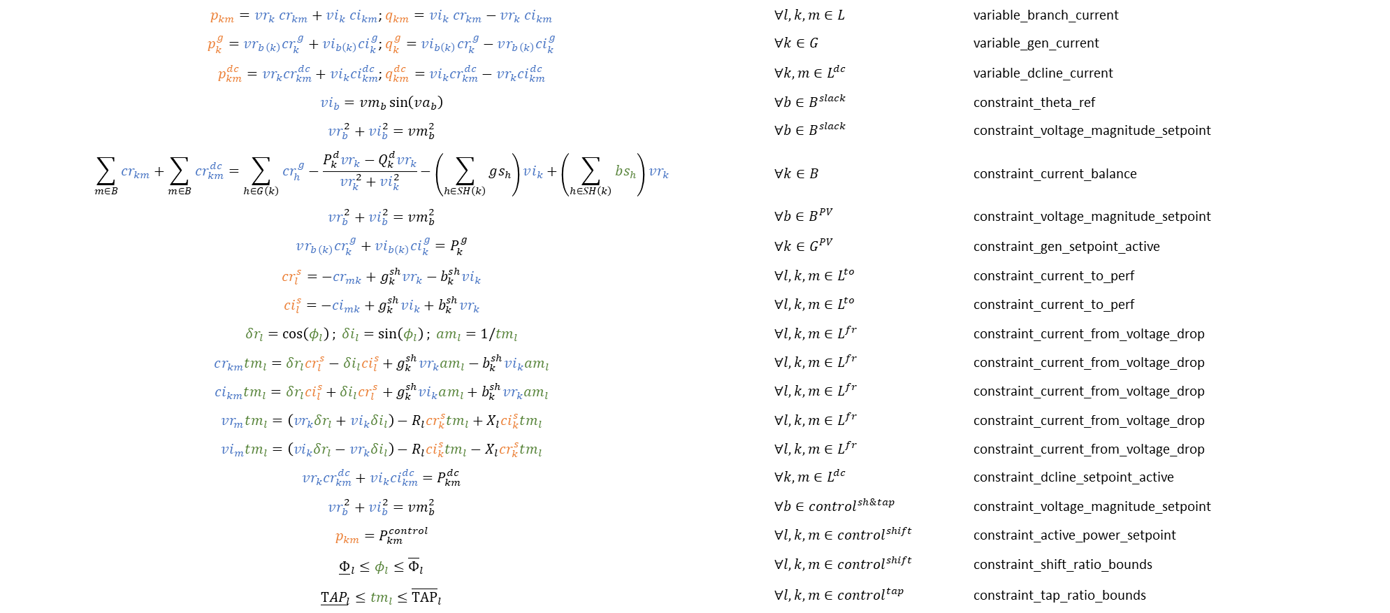
IVR com controle melhorado – ControlPowerFlow (Davi)
$p_{km}=vr_{k} cr_{km}+vi_{k} ci_{km}$; $q_{km}=vi_{k} cr_{km}−vr_{k} ci_{km}$ | $$∀l,k,m∈L$$ | variable_branch_current
$p_{k}^{g}=vr_{b\left(k\right)}cr_{k}^{g}+vi_{b\left(k\right)}ci_{k}^{g}$; $q_{k}^{g}=vi_{b\left(k\right)}cr_{k}^{g}−vr_{b\left(k\right)}ci_{k}^{g}$ | $$∀k∈G$$ | variable_gen_current
$p_{km}^{dc}=vr_{k}{cr}_{km}^{dc}+vi_{k}{ci}_{km}^{dc}$; $q_{km}^{dc}=vi_{k}{cr}_{km}^{dc}−vr_{k}{ci}_{km}^{dc}$ | $$∀k,m∈L^{dc}$$ | variable_dcline_current
$$vi_{b}=vm_{b}\sin\left(va_{b}\right)$$ | $$∀b∈B^{slack}$$ | constraint_theta_ref
$$vr_{b}^{2}+vi_{b}^{2}=vm_{b}^{2}$$ | $$∀b∈B^{slack}$$ | constraint_voltage_magnitude_setpoint
$$\sum_{m∈B}{cr_{km}}+\sum_{m∈B}{cr_{km}^{dc}}=\sum_{h∈G\left(k\right)}{cr_{h}^{g}}−\frac{P_{k}^{d}vr_{k}−Q_{k}^{d}vr_{k}}{vr_{k}^{2}+vi_{k}^{2}}−\left(\sum_{h∈SH\left(k\right)}{gs_{h}}\right)vi_{k}+\left(\sum_{h∈SH\left(k\right)}{bs_{h}}\right)vr_{k}$$ | $$∀k∈B$$ | constraint_current_balance
$$vr_{b}^{2}+vi_{b}^{2}=vm_{b}^{2}$$ | $$∀b∈B^{PV}$$ | constraint_voltage_magnitude_setpoint
$$vr_{b\left(k\right)}cr_{k}^{g}+vi_{b\left(k\right)}ci_{k}^{g}=P_{k}^{g}$$ | $$∀k∈G^{PV}$$ | constraint_gen_setpoint_active
$$cr_{l}^{s}=−cr_{mk}+g_{k}^{sh}vr_{k}−b_{k}^{sh}vi_{k}$$ | $$∀l,k,m∈L^{to}$$ | constraint_current_to_perf
$$ci_{l}^{s}=−ci_{mk}+g_{k}^{sh}vi_{k}+b_{k}^{sh}vr_{k}$$ | $$∀l,k,m∈L^{to}$$ | constraint_current_to_perf
$$δr_{l}=\cos\left(φ_{l}\right); δi_{l}=sin\left(φ_{l}\right); am_{l}=1/tm_{l}$$ | $$∀l,k,m∈L^{fr}$$ | constraint_current_from_voltage_drop
$$cr_{km}tm_{l}=δr_{l}cr_{l}^{s}−δi_{l}ci_{l}^{s}+g_{k}^{sh}vr_{k}am_{l}−b_{k}^{sh}vi_{k}am_{l}$$ | $$∀l,k,m∈L^{fr}$$ | constraint_current_from_voltage_drop
$$ci_{km}tm_{l}=δr_{l}ci_{l}^{s}+δi_{l}cr_{l}^{s}+g_{k}^{sh}vi_{k}am_{l}+b_{k}^{sh}vr_{k}am_{l}$$ | $$∀l,k,m∈L^{fr}$$ | constraint_current_from_voltage_drop
$$vr_{m}tm_{l}=\left(vr_{k}δr_{l}+vi_{k}δi_{l}\right)−R_{l}cr_{k}^{s}tm_{l}+X_{l}ci_{k}^{s}tm_{l}$$ | $$∀l,k,m∈L^{fr}$$ | constraint_current_from_voltage_drop
$$vi_{m}tm_{l}=\left(vi_{k}δr_{l}−vr_{k}δi_{l}\right)−R_{l}ci_{k}^{s}tm_{l}−X_{l}cr_{k}^{s}tm_{l}$$ | $$∀l,k,m∈L^{fr}$$ | constraint_current_from_voltage_drop
$$vr_{k}{cr}_{km}^{dc}+vi_{k}{ci}_{km}^{dc}=P_{km}^{dc}$$ | $$∀k,m∈L^{dc}$$ | constraint_dcline_setpoint_active
$$vr_{b}^{2}+vi_{b}^{2}=vm_{b}^{2}$$ | $$∀b∈{control}^{sh\&tap}$$ | constraint_voltage_magnitude_setpoint
$$p_{km}=P_{km}^{control}$$ | $$∀l,k,m∈{control}^{shift}$$ | constraint_active_power_setpoint
$${\underline{Φ}}_{l}≤φ_{l}≤{\overline{Φ}}_{l}$$ | $$∀l,k,m∈{control}^{shift}$$ | constraint_shift_ratio_bounds
$${\underline{TAP}}_{l}≤{tm}_{l}≤{\overline{TAP}}_{l}$$ | $$∀l,k,m∈{control}^{tap}$$ | constraint_tap_ratio_bounds
Variáveis: | $$v_{b}^{r},v_{b}^{i},c_{km}^{r},c_{km}^{i},cg_{k }^{r},cg_{k }^{i},tm_{l},φ_{l},δr_{l},δi_{l},am_{l}$$

